Slide 1
IDLE
A Python IDE
Ian Stewart
HamPUG - 12 May 2014

Slide 2
IDLE
Stands for...
"Integrated DeveLopment Environment"
Brief summary of features of IDLE:
Coded in 100% pure Python, using the tkinter GUI toolkit
Cross-platform: works on Windows, Unix, and Mac OS
Multi-window text editor with: multiple undo, Python colourizing, smart indent, call tips, auto-completion, and more...
Python shell window (a.k.a. interactive interpreter)
Debugger: Set breakpoints, view and step.
Intended to be simple and suitable for beginners.
Avoids “feature clutter”
Sometimes called a “disposable” IDE, as users frequently move on to a more advanced IDE as they gain experience.
For critical appraisal go here

Slide 3
IDLE - History
Original Author: Guido van Rossum - creator of Python
First release: 1998 with V1.5.2 of Python
Python releases: V1 – 1991, V2 – 2000, V3 - 2008
Version of IDLE is now the same as Python release, e.g. V3.4.
Distributed with every Cpython release.
Python repository: was Subversion http://svn.python.org/ now moved to: Mercurial http://hg.python.org/
IDLE on Mercurial http://hg.python.org/cpython/file/tip/Lib/idlelib/

Slide 4
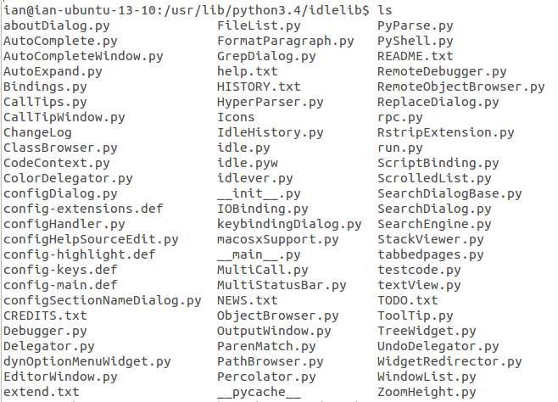
IDLE package
When installed on Linux, located in /usr/lib/python3.x/idlelib/
~75 .py files.
EditorWindow.py and PyShell.py provide the 2 main windows

Slide 5
IDLE – Dependencies / Installation
Tkinter. Tool Kit Interface. A wrapper for the GUI widgets “Tk”.
Tkinter package (lib-tk) is also on Mercurial: http://hg.python.org/cpython/file/a9d34685ec47/Lib/lib-tk
Distributed with Cpython. Installed in: /usr/lib/python3.x/tkinter/
Tcl/Tk. Two Open Source Software packages. http://www.tcl.tk/
Tcl “Tool Command Language”. Programming language, released in 1988.
Tk “Took Kit” of GUI widgets for developing desktop applications. Released 1991.
Tcl/Tk location: /usr/lib/libtk8.5.so.0 and /usr/lib/libtcl8.5.so.0
To install IDLE: sudo apt-get install idle (for Python v2), sudo apt-get install idle3 (for Python v3)
Install tk: sudo apt-get install python3-tk or $ apt-get install tk

Slide 6
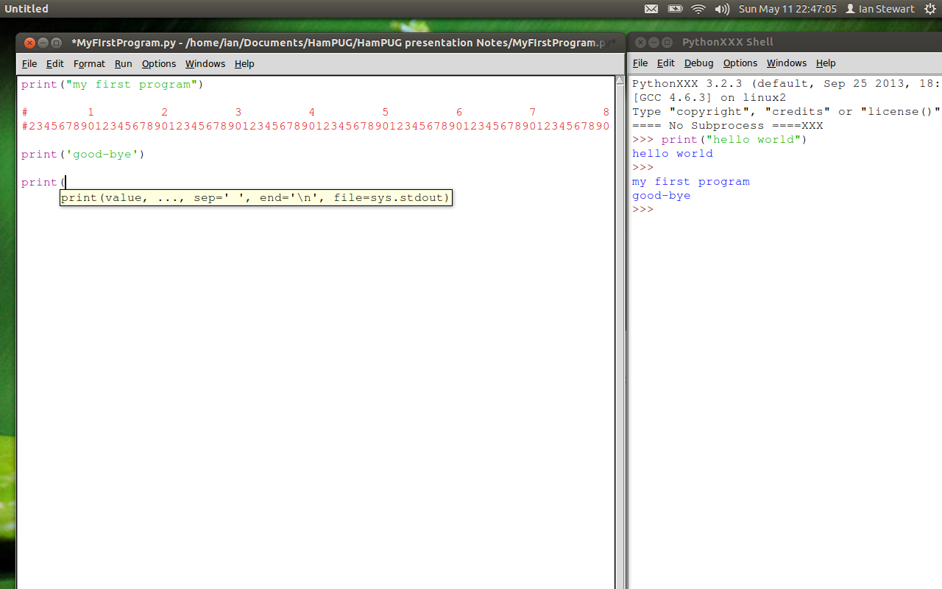
IDLE Main Windows
Editor Window(s). Showing “call tip” for print function
PyShell. Interactive interpreter, with program execution output.

Slide 7
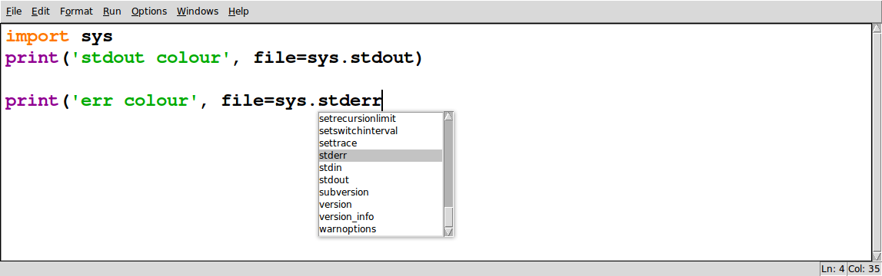
IDLE – Auto-complete window
Completion prompting for the imported “sys” module.
~2 second delay before completion window pops up.
Use up / down arrows to highlight desired selection.
Double tab to accept highlighted selection.
OR: “Ctrl Space” to immediately launch auto-completion window, start typing, and single tab for completion.

Slide 8
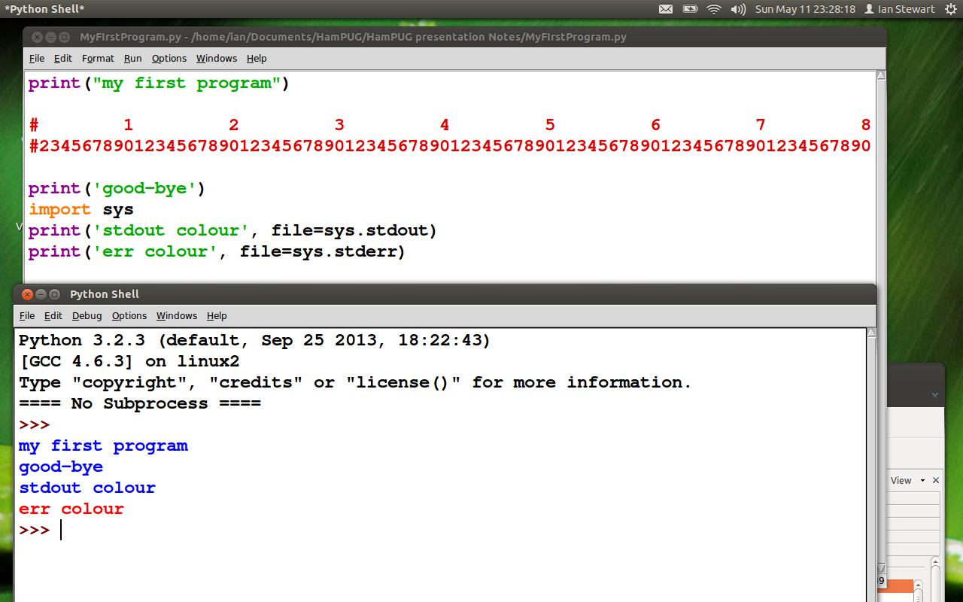
IDLE – PyShell output colour
stdout = blue, stderr = red

Slide 9
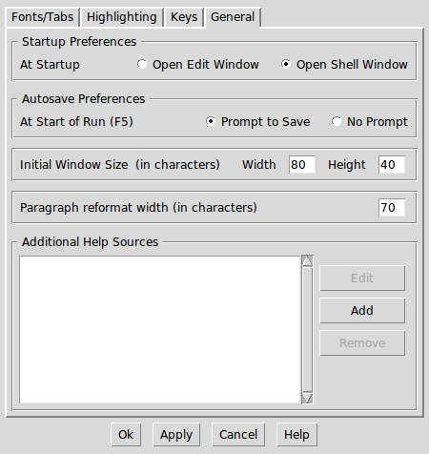
IDLE – Configuration or preferences
General

Slide 10
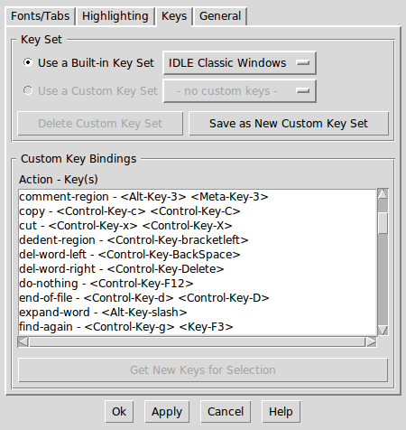
IDLE – Configuration of preferences
Keys: “Alt 3” to comment a region and “Alt q” to format regions

Slide 11
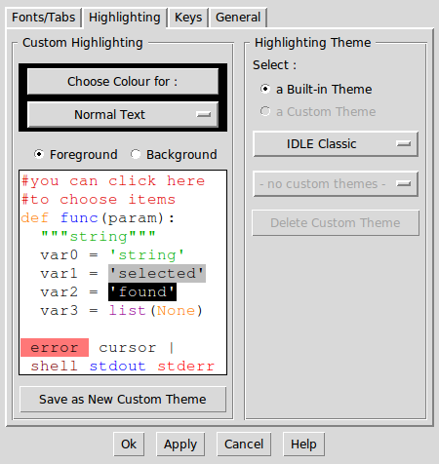
IDLE – Configuration of preferences
Highlighting

Slide 12
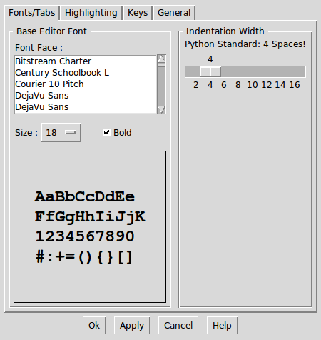
IDLE – Configuration of preferences
Fonts/Tabs

Slide 13
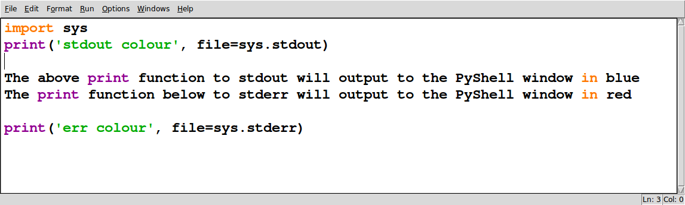
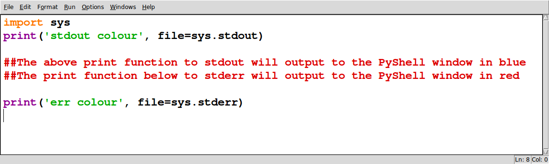
IDLE – Adding comments
Alt 3 / Alt 4 add/remove comments to a selected region

Slide 14
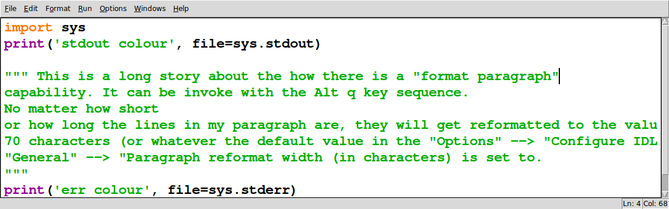
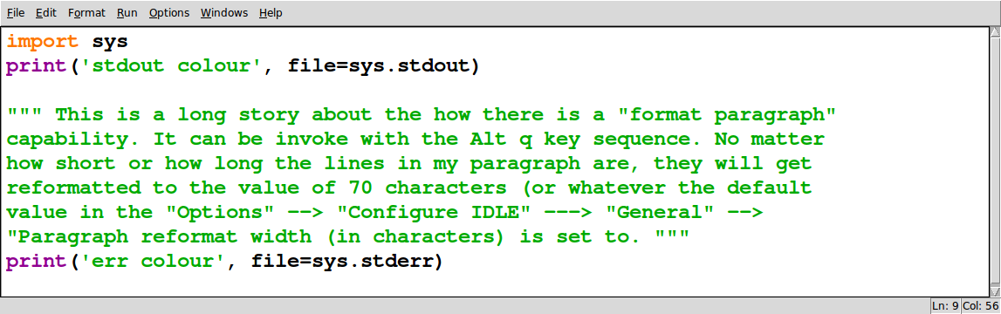
IDLE – Reformating – Alt q

Slide 15
IDLE - Documentation
Menu bar: Help →IDLE Help
Terminal prompt: idle -h
https://docs.python.org/2/library/idle.html
https://docs.python.org/3/library/idle.html
Search YouTube for videos. eg...
http://www.youtube.com/watch?v=pEFr1eYIePw
http://www.youtube.com/watch?v=lBkcDFRA958
http://www.youtube.com/watch?v=F_MXPT2G9-4

Slide 16
Any Questions? / Demo IDLE...

